Slide 1


Influence of Covid restrictions on real estate prices in Australia
Leonie Flueckiger
11/16/2020
The Data Incubator – Capstone Project

Slide 2
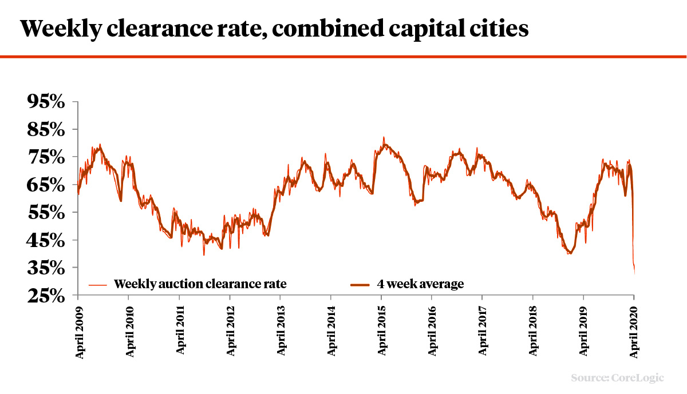
Objective
Covid pandemic changed our lives and housing market
Due to social distancing measures national residential listings were down 33 % in April 2020, weekly clearance rate dropped
revenue loss for real estate agents and mortgage brokers
My objective is to disentangle relationship between restrictions on house inspections and real estate auctions with number of listed properties and housing prices

Slide 3
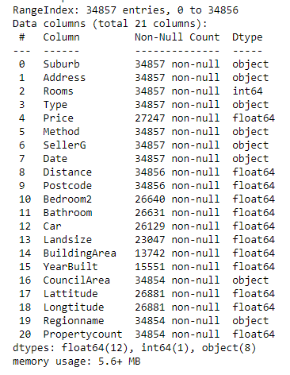
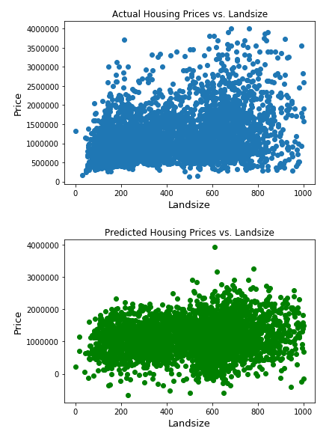
Exploratory Data Analysis and Machine Learning
Kaggle dataset of Melbourne Housing prices from 2016 to 2018 https://www.kaggle.com/anthonypino/melbourne-housing-market
Data cleanup
Feature engineering
Linear Regression to predict property prices
https://github.com/leonie-on-git/DataIncubator/blob/main/Capstone.ipynb

Slide 4
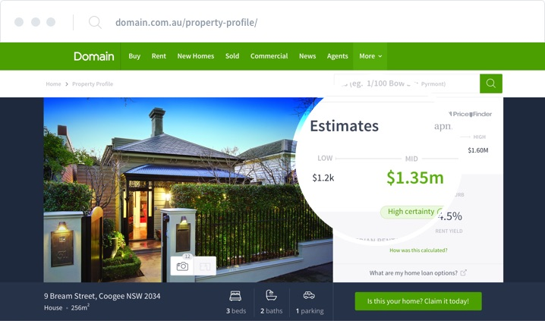
Data access and Analysis
Real estate listings and prices for the last 10 years from 4 Australian cities
Sydney (strongly hit by first wave), Melbourne (restrictions during second wave), Adelaide (about to go into lockdown) and Perth (only mild restriction)
Accessible through the domain.com.au API ~100 MB
Data on social distancing measures and their dates of imposing
Data an migration to and from Australia in last 10 years
Forecast of change in listing availability and housing prices during Covid-19 lockdown
Help real estate agents with fast pivots and decision-making to prevent revenue loss

